Slide 1

AI-Powered Resume Screening and Candidate Ranking System
CSA0974-JAVA PROGRAMMING FOR DEVELOPERS
DONE BY:
VISHALI P -192524313
SOUNDARIYA M -192524342
KIRUTHIKA B-192511232
GUIDED BY:
DR MOHAN R
DR MEGANATHAN

Slide 2


INTRODUCTION
This project is a web-based application that automates the process of screening resumes and selecting suitable candidates for job openings.
The system uses Artificial Intelligence (AI) and Natural Language Processing (NLP) to extract skills, qualifications, and experience from uploaded resumes.
It compares candidate profiles with job requirements and generates a score to rank applicants based on their suitability.
The system reduces manual effort, saves recruitment time, improves hiring accuracy, and helps recruiters make better decisions.

Slide 3
METHODOLOGY
Resume Collection and Upload Candidates upload their resumes in PDF or DOCX format through the web application, and the system stores them securely in the database.
Information Extraction AI and NLP techniques are used to extract important details such as skills, education, experience, certifications, and keywords from the resumes.
Job Matching and Scoring The extracted information is compared with job requirements, and a matching score is calculated based on skill and qualification relevance.
Candidate Ranking and Reporting Candidates are ranked according to their scores, and recruiters can view the results through a dashboard and generate reports for hiring decisions.

Slide 4
LITERATURE REVIEW:
Traditional resume screening is a manual process that takes a lot of time and effort.
AI helps automate the screening process by analyzing resumes quickly.
Natural Language Processing (NLP) is used to extract skills, education, and experience from resumes.
Machine Learning algorithms compare candidate profiles with job requirements.
The system ranks candidates based on their suitability for a job position.

Slide 5
SYSTEM IMPLEMENTATION
User Interface Layer Recruiters and candidates interact with the system through a web interface for login, resume upload, job posting, and viewing results.
Application Layer (Spring Boot) Handles business logic, user authentication, resume processing, candidate ranking, and communication between the frontend and database.
AI/NLP Processing Layer Extracts skills, education, experience, and keywords from resumes and matches them with job requirements to generate candidate scores.
Database Layer (MySQL/PostgreSQL) Stores user information, resumes, job postings, extracted data, candidate scores, and recruitment reports securely.

Slide 6
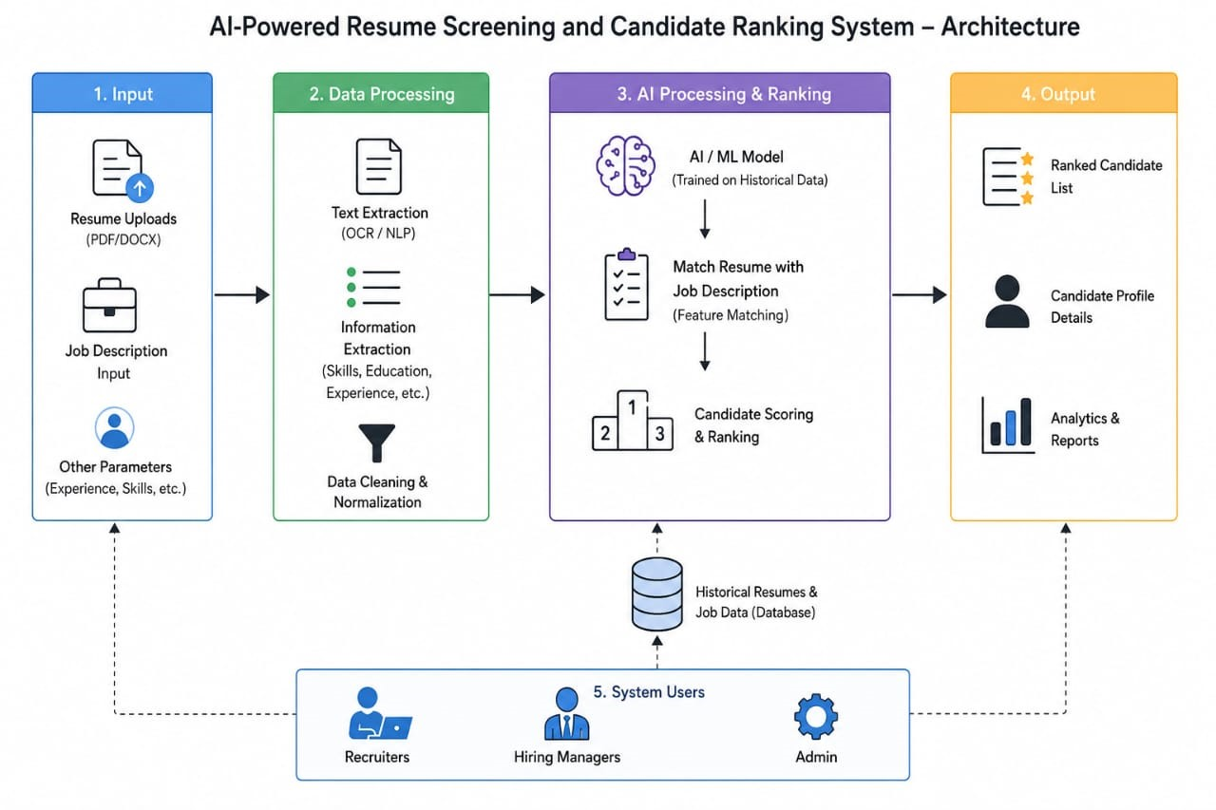
SYSTEM ARCHITECTURE:

Slide 7
MODULE 1- Resume Processing and Skill Extraction
Resume Upload Candidates can upload resumes in PDF or DOCX format
Resume Parsing The system extracts text and relevant information from uploaded resumes automatically.
Skill Extraction AI/NLP techniques identify technical skills, soft skills, certifications, and qualifications.
Experience & Education Analysis The system extracts candidate experience, educational background, and achievements.
Data Storage Extracted information is stored in the database for further matching and ranking processes.

Slide 8
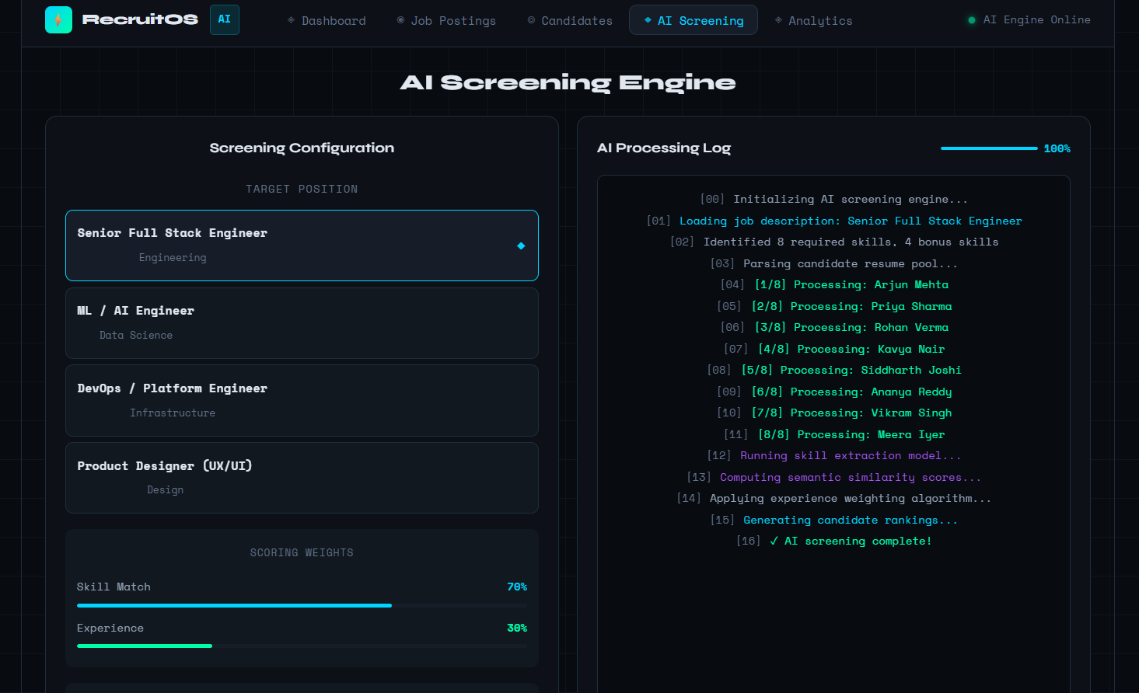
MODULE 1- Resume Processing and Skill Extraction

Slide 9
MODULE 2-Candidate Screening and Matching
User Registration Allows recruiters and candidates to create accounts and access the system.
User Login & Authentication Provides secure login using username/email and password verification.
Profile Management Users can update personal details, contact information, and account settings.
Job Posting Management Recruiters can create, edit, view, and delete job postings with required skills and qualifications.
Role-Based Access Control Different access permissions are provided for recruiters and candidates to ensure system security.

Slide 10
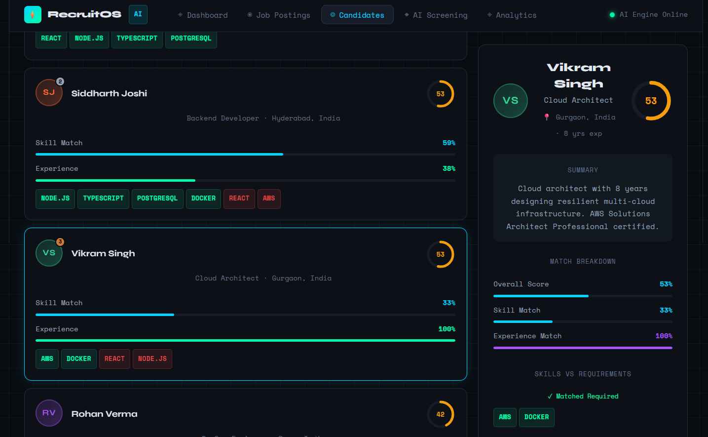
MODULE 2-Candidate Screening and Matching

Slide 11
MODULE 3-Candidate Ranking and Reporting
Candidate-Job Matching The system compares extracted resume data with job requirements to find suitable candidates.
Resume Scoring Candidates are assigned scores based on skills, qualifications, experience, and keyword matching.
Candidate Ranking Applicants are ranked in descending order according to their matching scores.
Recruiter Dashboard Recruiters can view ranked candidate lists and analyze applicant details through an interactive dashboard.
Report Generation The system generates reports on candidate rankings, hiring statistics, and recruitment performance.

Slide 12
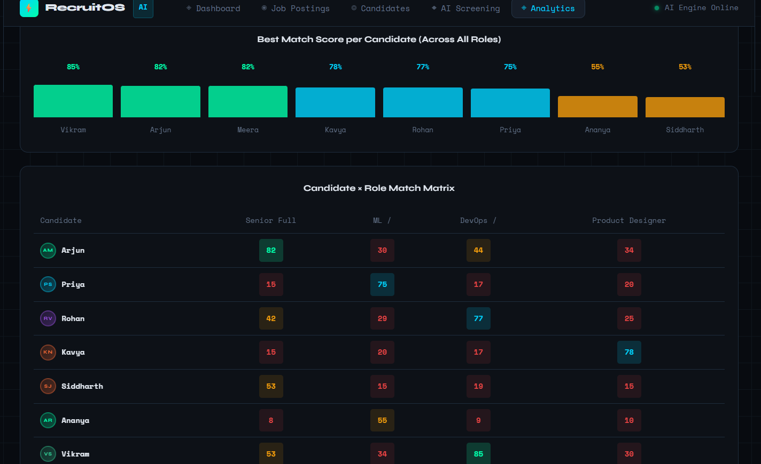
MODULE 3-Candidate Ranking and Reporting

Slide 13
CONCLUSION
The system automates the resume screening process, reducing manual effort and recruitment time.
AI and NLP techniques help extract candidate skills, qualifications, and experience accurately.
Candidate-job matching and ranking improve the quality and efficiency of hiring decisions.
The system provides a smart, scalable, and reliable solution for modern recruitment and talent acquisition.

Slide 14
FUTURE SCOPE
Integration with real AI/NLP models for advanced resume analysis.
Automatic PDF and DOCX resume parsing.
Real-time job recommendation system for candidates.
Interview scheduling and notification management.
Integration with job portals such as LinkedIn and Indeed.
AI-based interview question generation.

Slide 15
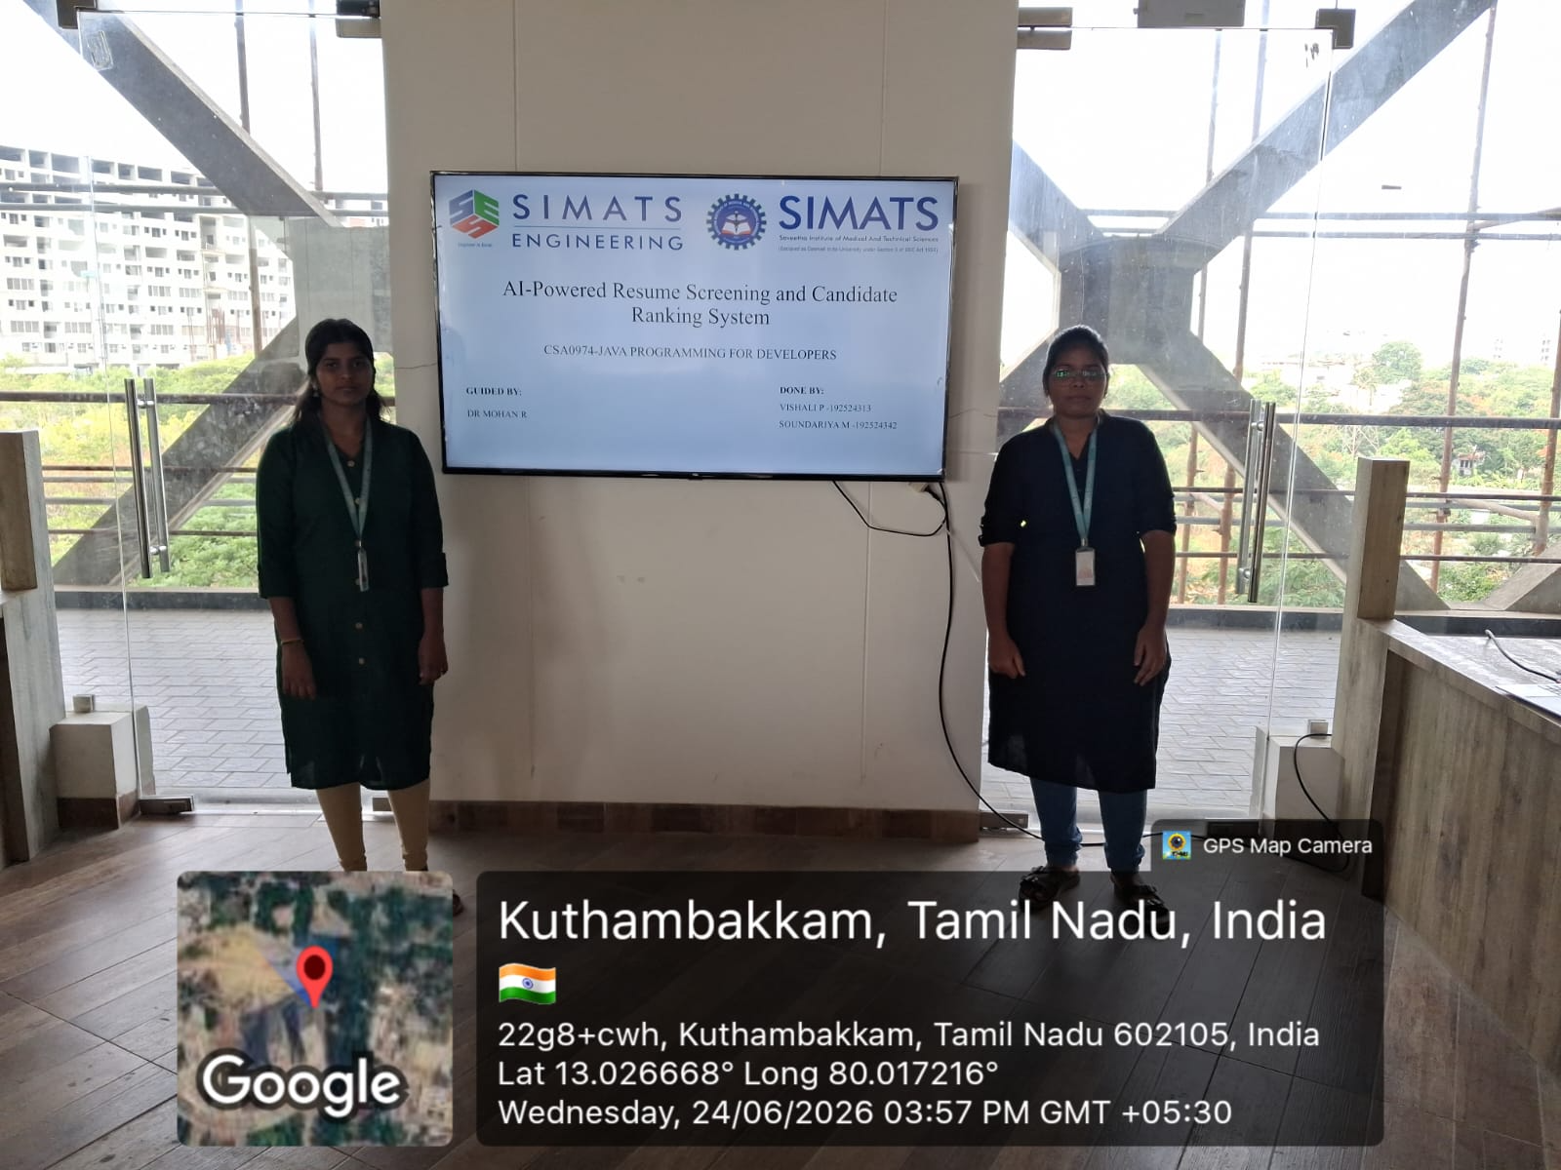

Slide 16
REFERENCES
Reddy, A. V. K., Ratnam, K. V., Narasimha, N., & Pavan Kalyan, C. (2025). AI-Driven Resume Parsing and Ranking System: Leveraging NLP and Machine Learning for Efficient Recruitment. EAI ICITSM, 2025.
Wilson, K., Sim, M., Gueorguieva, A. M., Chatterjee, S., & Caliskan, A. (2026). Resume Screening, Fast and Slow: (Biased) AI Recommendations' Influence on Human Decision Making. arXiv, 2026.
Reddy, A. V. K., Ratnam, K. V., Narasimha, N., & Pavan Kalyan, C. (2025). AI-Driven Resume Parsing and Ranking System: Leveraging NLP and Machine Learning for Efficient Recruitment. EAI ICITSM, 2025.
Barath, G. V., Sanjev, R., Shenbaga Priya, V., et al. (2025). AI-Driven Recruitment: Resume Screening and Skill Matching with NLP. IEEE Conference, 2025.
Yadav, K. S., & Matthew, B. H. (2025). AI-Powered Resume Screening and Job Matching System for Intelligent Career Guidance and Recruitment Optimization. International Journal on Science and Technology, 2025.

Slide 17
THANK YOU

